Slide 1
Extending theMOC-UI
Team Member: Thomas Hsu, William Vangos, Alex Wong, Hang Xu
Project Mentor: Jon Bell

Slide 2
What is MOC-UI
An user interface for the Massachusetts Open Cloud.
We seek to provide a more user friendly experience for researchers and users over the Horizon UI

Slide 3
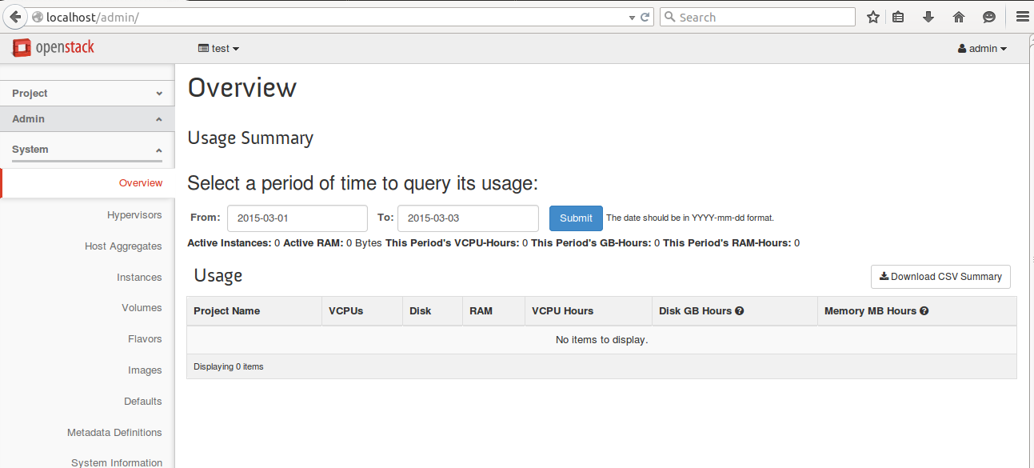
Horizon UI

Slide 4
Goals
Replace Horizon UI
Develop a dynamic marketplace for cloud computing services
Manage user accounts
Configure marketplace services
Implement a simple and efficient UI

Slide 5
Previous Work
Incomplete UI developed by previous team
User login, project creation
Hard-coded variables (usernames, passwords, marketplace services)
Our goal: Construct a dynamic marketplace with increased functionality

Slide 6
Progress
Configured DevStack for our VMs
Explored existing MOC-UI and code
Determined hard coded values, limited functionality
Implemented user creation/deletion, project association, and visual improvements.

Slide 7
Demo

Slide 8
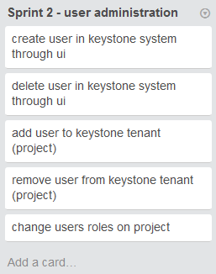
Current Sprint

Slide 9
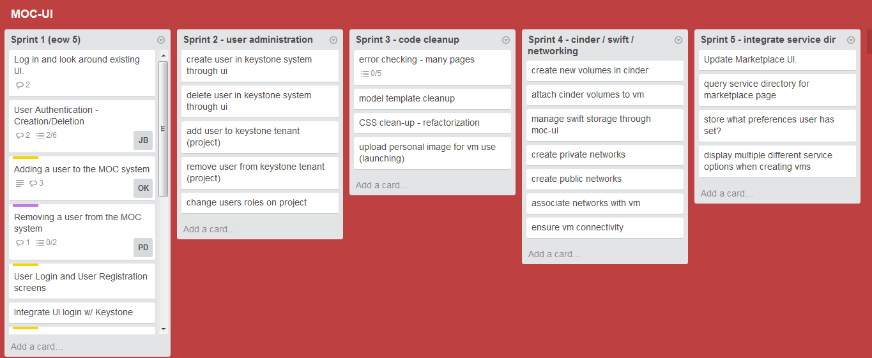
Future Sprints

Slide 10
Thanks

